Slide 1
Welcome to Year Four

Slide 2
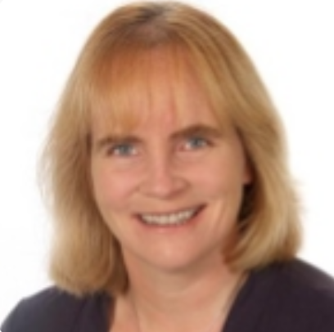
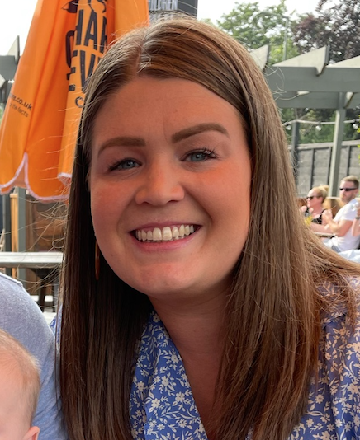
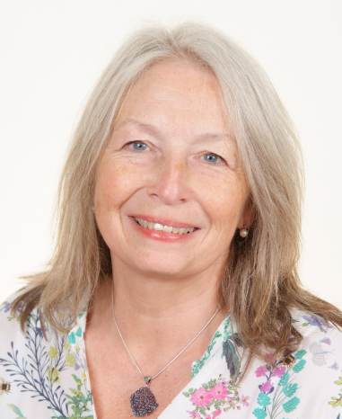
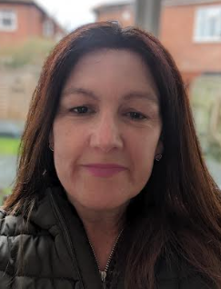
Meet the Year 4 Team…
Mrs Wilkinson
Deputy Head & DSL
Class 9 Teacher
Miss Traill
Assistant Head
Class 9 Teacher
Miss Wyeth
Class 10 Teacher
Mrs Potter
Year 4
Teaching Assistant

Slide 3
Our Curriculum
We are on a mission to support all pupils to ‘grow their learning’ by developing all five branches of our tree.
Our broad and balanced curriculum reflects this.
We are committed to giving pupils the literacy and numeracy diet they need to support their learning now, in the future and to enable them to access the world around them.
We want all pupils to see themselves as learners who can continue to grow, enjoy and develop their learning at Appletree and beyond.
Notes:
JW

Slide 4
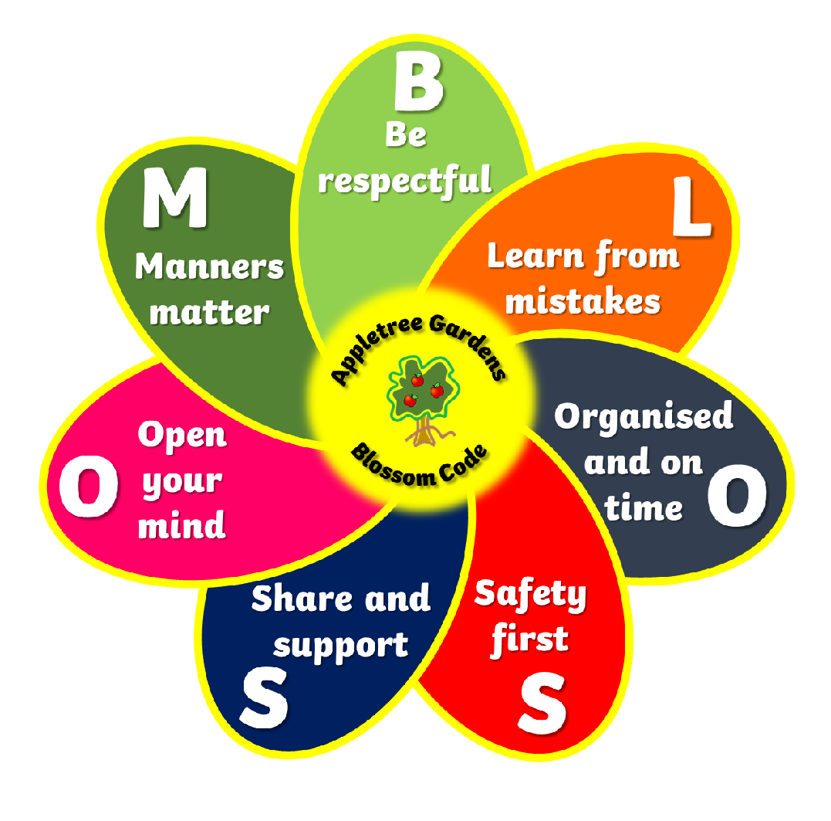
The Blossom Code Quiz
Notes:
JT

Slide 5
The Blossom Code
Notes:
JT

Slide 6
Our enquiry approach to learning
Our long term planning for 2023-2024 is on our website (hotlink to website here). It breaks down the content coverage over the year.
Our medium and short term planning supports pupils to question the world around them and gather and use evidence to support judgements. We celebrate our learning with a meaningful or real life scenario to enable pupils to put their knowledge and skills into context.
During Autumn 1 the children will have a full curriculum which includes learning about World War Two, Mechanisms, Forces and Magnetism, Islamin in RE, les animaux in French and all about ‘Being Me’ in PSHE.
Notes:
SW

Slide 7
Grow Your Speaking and Listening in Year Four
The quality and variety of language that pupils hear and speak are vital for developing their vocabulary and grammar and their understanding for reading and writing. Our ambition is to ensure the continual development of pupils’ confidence and competence in spoken language and listening skills.
Teachers model speaking and listening skills to develop pupils’ spoken language.
Clear focus upon explicit vocabulary development.
Each lesson has a vocabulary focus.
Lots of carefully planned opportunities -
discussions, presentations, performances, role play and debates.
Notes:
JT

Slide 8
Grow Your Reading in Year Four
Our ambition is to equip all learners with the knowledge and skills needed to become independent, fluent, life-long readers who read widely and often.
Read confidently and independently across a range of text types
Read most words with accuracy and fluency
Understand what they have read - identify and summarise
main ideas in a text
Discuss vocabulary used by the author to create effect
Use inference and prediction skills
Whole class reading, Talk for Reading, Talk for Writing,
Reading across the curriculum, Shared Class Story, Books to Share
Library visits, Book Babble/Recommendations, Home-School Readers
Notes:
JT

Slide 9
Grow Your Reading in Year Four
Teachers and Parents are in a great position to ensure that reading is
a key part of children’s daily routine.
Reading books to be in school each day.
Books will be checked and changed each Monday.
Adults to hear children read at home x3 per week and recorded.
Encourage your child to read for at least 15 mins each day.
Books to share changed each Friday.
Library membership
Reading for pleasure
Evidence suggests that there is a positive relationship between reading frequency, reading enjoyment and attainment.
Notes:
JT

Slide 10
Grow Your Reading in Year Four
Notes:
JT

Slide 11
Grow Your Writing in Year Four
Children are provided with many opportunities to develop and apply their writing skills across the curriculum. It is our ambition that they are able to speak, read and write fluently so that they can communicate their ideas and emotions effectively.
purpose and audience
range of punctuation (! , () ? “‘)
settings, characters
paragraphs
correct tense
coherent plot
variety of non- fiction and poetry
statutory spellings
form and join letter correctly
Notes:
JT

Slide 12
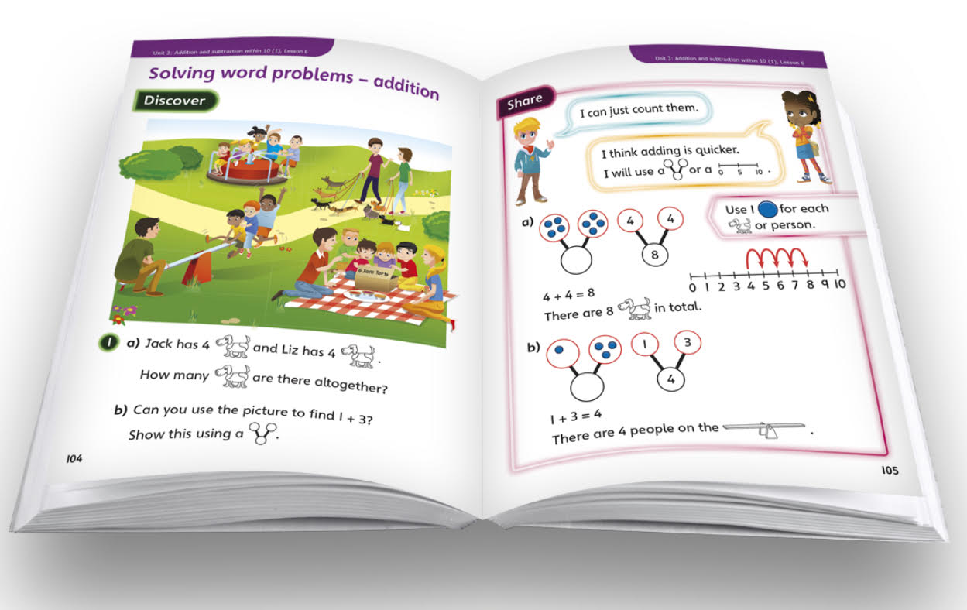
Grow Your Maths in Year Four
Maths will continue to be taught through a mastery approach. Children will continue to learn through practical activities using familiar resources to build on and deepen concepts, understanding, skills and knowledge from year 3.
We want our children to be confident mathematicians who are able to apply their skills to solve problems, learning from mistakes and showing resilience.
Notes:
SW

Slide 13
Multiplication Tables Check
The multiplication tables check (MTC) is statutory for all year 4 pupils registered at state-funded maintained schools, special schools or academies (including free schools) in England.
The purpose of the MTC is to determine whether pupils can recall their times tables fluently, which is essential for future success in mathematics. It will help schools to identify pupils who have not yet mastered their times tables, so that additional support can be provided.
Notes:
SW

Slide 14
Science, Technology, Engineering and Mathematics (STEM)
Cross curricular topics | Kodu Project
Forest school | Each class to visit forest school once per half term
STEM club | Eg. Construction Club
STEM visits/visitors | Glendale Show
Activity weeks | Robinwood Science week Enterprise Week
Notes:
JW

Slide 15
Robinwood
Notes:
JT SW

Slide 16
Curriculum support - Meeting individual needs
We understand that all children learn and progress at different rates. We follow a graduated approach in order to meet all pupils needs.
Classroom adjustments to support learning (this includes differentiated tasks, prompts/materials to encourage independent learning and challenges to extend learning)
Homework tasks, directing parents and carers to appropriate resources, apps and websites.
Specific programmes/interventions (e.g dyslexia, literacy and numeracy interventions)
Blossom Club - children may be invited to this in order to support their learning/homework.
Support plans - involvement with SENCO and external professionals, regular reviews
Pastoral support - mindfulness, thrive, signposting to help - eg. Supernanny
Notes:
JW

Slide 17
How can I get involved as a parent/carer in Year Four?
Homework
- MyMaths and TTRS
- Spellings
- Reading (logged on Boom Reader)
- Homework books with fortnightly tasks to be shared in class.
Times Table Challenge - TTRS and year group competition
Reading challenges
Homeschool reading - everyday and logged on Boom Reader
Books to share - weekly
Notes:
SW

Slide 18
How can I get involved as a parent/carer in Year Four?
Drop in dates:
Autumn 1: Reading
Spring 1: Writing
Summer 1: Maths
Statutory meeting: Multiplication check
Assemblies:
Autumn Term - Christmas performance
Spring Term - Year Group Assembly
Summer Term - Appletree’s Got Talent
Reading at home
Homework support
Trips, visits, visitors, secret reader, careers days, library helper
Notes:
JW

Slide 19
Clubs
Blossom Club
Access Coaching Sports Clubs
KS2 Choir
Dance Club
Homework Club
Gardening Club
Lingo Tots
Mindful Me
Extra Responsibilities:
PE Leaders and Monitors
Reception Buddies
Eco Warrior
School Councillor
Blossom Buddies
STEM Leader
Maths Leader
Notes:
JT

Slide 20
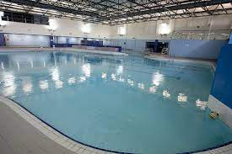
Organised and On Time
PE days
To be confirmed
Swimming on Tuesdays
Autumn 1 and Spring 1 = Class 9
Autumn 2 and Spring 2 = Class 10
Forest School Days:
Both classes will visit Forest School once each half term. Please wear suitable
clothing.
Notes:
JT

Slide 21
Organised and On Time
“Being around teachers and friends in a school environment is the best way for pupils to learn and reach their potential. Time in school also keeps children safe and provides access to extra-curricular opportunities and pastoral care.
The higher a pupil’s attendance, the more they are likely to learn, and the better they are likely to perform in assessments.”
Department for Education, Education hub, May 2023
Notes:
JW

Slide 22
Organised and On Time
Notes:
JW

Slide 23
Organised and On Time
Gates open at 8:40am and close at 8:55am. Children should be registered and ready to learn for 9am.
Lates (pupils coming through the main entrance) are recorded and monitored so that we can support.
Notes:
JW

Slide 24
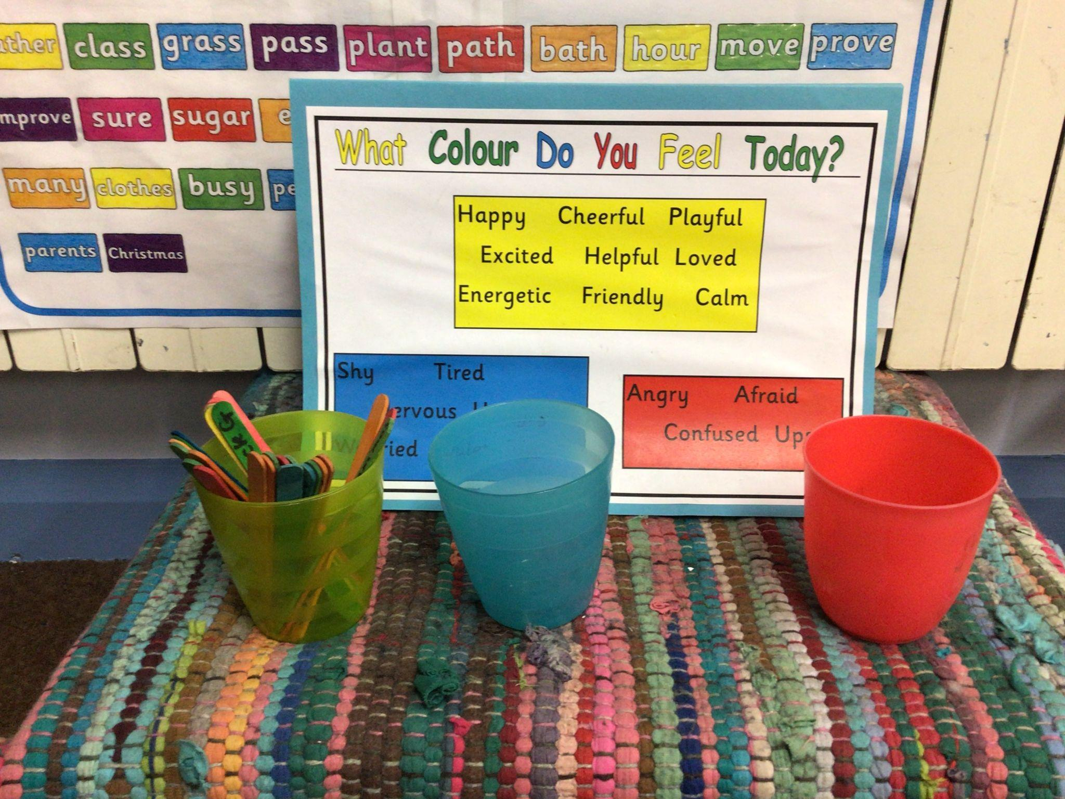
Supporting Mental Health in school
Blossom code/BLOSSOM buddies
Mental Health Registers
Jigsaw program
Thrive trained staff and Thrive interventions
Thrive room/quiet spaces around school
Supernanny
SEND support
Give me five/Value assemblies/Celebration assemblies
Pupil led theme weeks: odd socks, wellbeing
Metacognition
Early Help
Poverty proofing
Parent - School communication
Pupil responsibilities: Eco-warriors, school council, PE leaders..
Notes:
SW

Slide 25
How can we support you? Parents as Partners
Parent consultations/progress updates.
Work with parents to support Blossom Code.
Use of Seesaw to communicate.
Daily conversations on the door.
Early Help and support if required.
Supernanny
SENDCo
Notes:
JT

Slide 26
How to keep in touch…
Attendance: Please report all school absences to the school office via phone call.
Teacher: Quick message at the door upon arrival or at the end of a school day. If a longer time is needed please arrange a phone call/appointment.
Newsletter: Updated monthly on the school website.
Seesaw: All families will be given access to their child’s year group seesaw page. This is our learning platform where we can share work and feedback.
Twitter: A frequently updated twitter feed can be found online by searching for @AGFS_Year4 and @Appletree_First.
Notes:
JW

Slide 27
Birthday Biscuits
In the new academic year, we will continue with pupils celebrating their with the opportunity to wear their own clothes to mark the special occasion and the class will share biscuits.
We will no longer accept food or gifts from home. This is to support all pupils to have an equal celebration in school on their special day. Pupils whose birthday falls in any holiday period will be given a date in the week / or weeks before the holiday.
We will collect biscuit donations in September. The biscuits will be kept in the classrooms ready for pupil birthdays in the new academic year.
Please do not send in any biscuits that contain nuts (check the small print) and as always, we will consider additional allergies and pupil food choices before sharing a treat.
Notes:
SW

Slide 28
Websites
Maths
Top Marks - https://www.topmarks.co.uk
My Maths - https://www.mymaths.co.uk/
Daily 10 - https://www.topmarks.co.uk/maths-games/daily10
Numeracy Games - https://www.bbc.co.uk/bitesize/subjects/zjxhfg8
Times Table Rock Stars - login details will be available from September
Literacy
Spellings - https://www.ictgames.com/mobilePage/literacy.html
Oxford Owl - https://home.oxfordowl.co.uk/learning-at-home-8-9/
Notes:
SW

Slide 29
Any questions?
Notes:
JT

